Slide 1
Unsupervised Language Learning
Tran Cong Nguyen, Lautaro Quiroz,
Roger Wechsler

Slide 2
Outline
Overview and goals
Implementation
Results

Slide 3
Overview / Goals
Goal: Find the best Tree Substitution Grammar (TSG) for the “numerical” data
Procedure:
Define a simple CFG that generates numbers
Parse the corpus, randomly extract elementary trees and create an initial TSG
Make small changes to the data and check if data likelihood improves in order to find best TSG

Slide 4
Overview / Goals
Extract numeral data from the Penn WSJ Treebank.
Procedure:
Look for tags “CD”.
Extract the values inside this tag.
If in alphabetic form, translate to number form.

Slide 5
Overview / Goals
Examples:
“12” → 12.
“two hundred” → 200.
“1.45 million” → 1,450,000.
“early-1980s” → 1980.
etc.

Slide 6
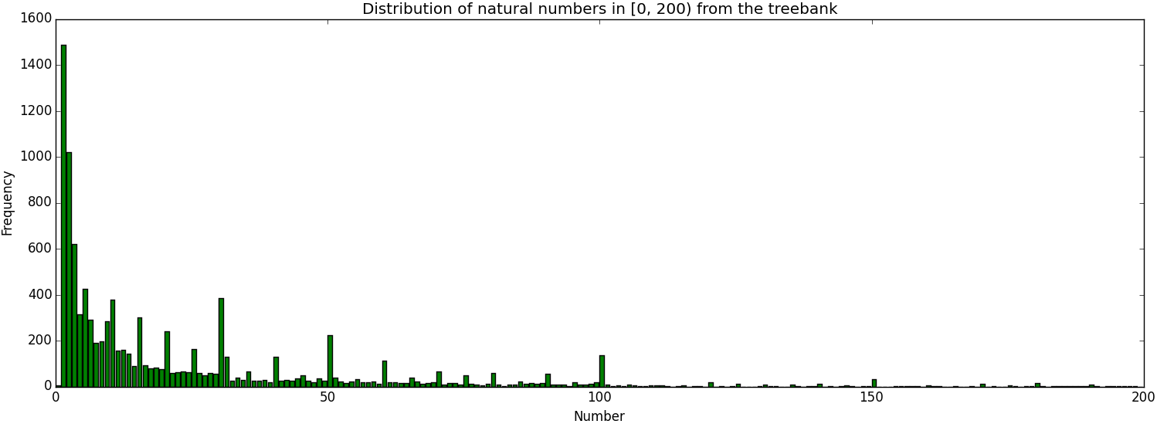
Overview / Goals

Slide 7
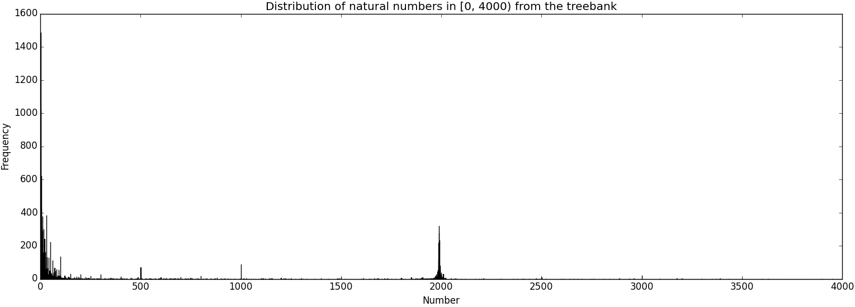
Overview / Goals

Slide 8
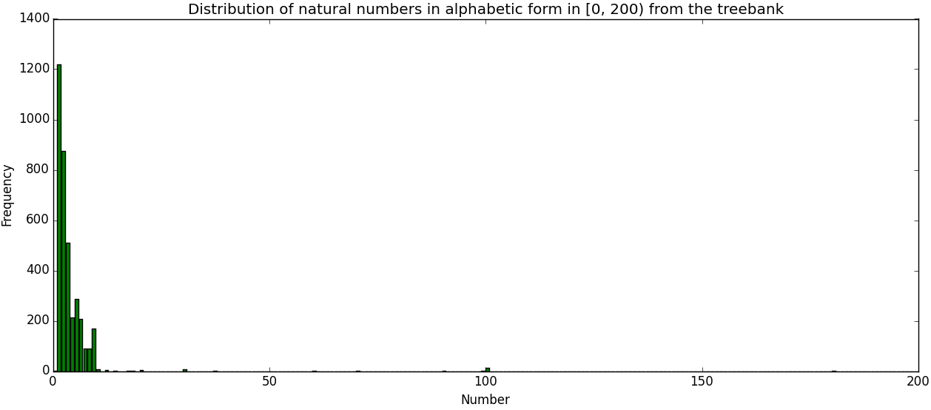
Overview / Goals

Slide 9
Overview / Goals
Total number of numbers:
Number form: 9.392
Alphabetic form: 3.728
Both forms: 13.120

Slide 10
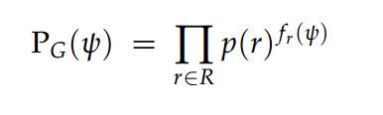
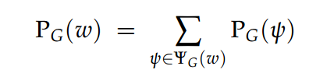

Overview / Goals
Extension: instead of using the probability of the best derivation of a string, use the actual likelihood of a string
p(derivation): p(string):
p(best derivation):

Slide 11
Overview / Goals
Expectation: Using the exact data likelihood while sampling leads to a better TSG than using an approximated data likelihood.
Problems:
Fast implementation is indispensable
How to measure differences between two approaches

Slide 12
CDEC Decoder
Cdec is a decoder and aligner used in Machine Translation
It translates sentences while deriving syntax trees for both the target and source language.
CFG for source and target required.
in C++ and Python-wrapper
provides inside probability of root symbol

Slide 13
Example PCFG
[S] ||| [D,1] ||| [D,1] ||| LogProb=-0.69314
[S] ||| [S1,1] [S2,2] ||| [S1,1] [S2,2] ||| LogProb=-0.69314
[S1] ||| [NZ,1] [S2,2] ||| [NZ,1] [S2,2] ||| LogProb=-0.69314
[S1] ||| [NZ,1] ||| [NZ,1] ||| LogProb=-0.69314
[S2] ||| [D,1] [S2,2] ||| [D,1] [S2,2] ||| LogProb=-0.69314
[S2] ||| [D,1] ||| [D,1] ||| LogProb=-0.6931
[D] ||| 1 ||| 1 ||| LogProb=-2.3025850
...
root
Source language
Target language
Probability

Slide 14
Metropolis-Hastings Sampling
Repeat:
Generate a random candidate change
Remove or add substitution site marker
Compute new likelihood L_{new} of the data with change
Accept candidate change in two cases:
if L_{new} > L_{old} always accept
otherwise accept with probability L_{new} / L_{old}

Slide 15
Grammars for Numerals
Deterministic:
[S] → [0] | [1] | [2] | … | [9]
[S] → [1] [P] | [2] [P] | [3] [P] | … | [9] [P]
[P] → [0] | [1] | [2] | … | [9]
[P] → [0] [P] | [1] [P] | [2] [P] | … | [9] [P]
Only one derivation is possible

Slide 16
Grammars for Numerals
Half ambiguous:
[S] → [D] [D] | [S1] [S2]
[S1]→ [NZ] [S2] | [NZ]
[S2]→ [D] [S2] | [D]
[NZ]→ [1] | [2] | [3] | … | [9]
[D] → [0] | [1] | [2] | … | [9]
Not deterministic

Slide 17
Grammars for Numerals
Highly ambiguous:
[S] → [Z] | [NZ] | [S1] [S2]
[S1]→ [NZ] | [NZ] [S2] | [S1] [S2]
[S2]→ [Z] | [NZ] | [Z] [Z] | [Z] [NZ] | [NZ] [Z] | [NZ] [NZ]
[NZ]→ [1] | [2] | [3] | … | [9]
[Z] → [0]
Many parses

Slide 18
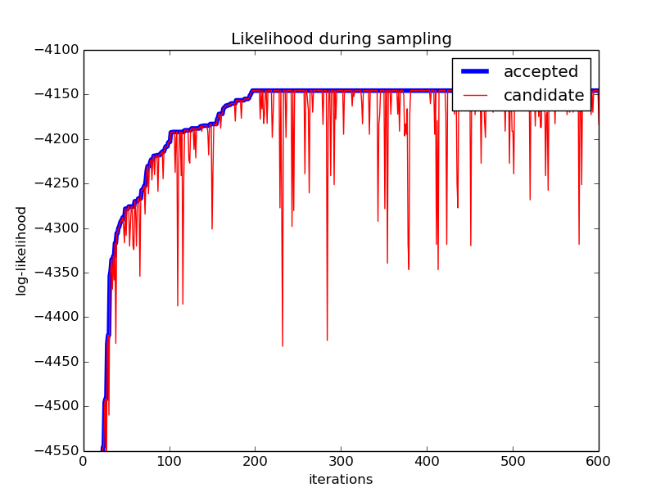
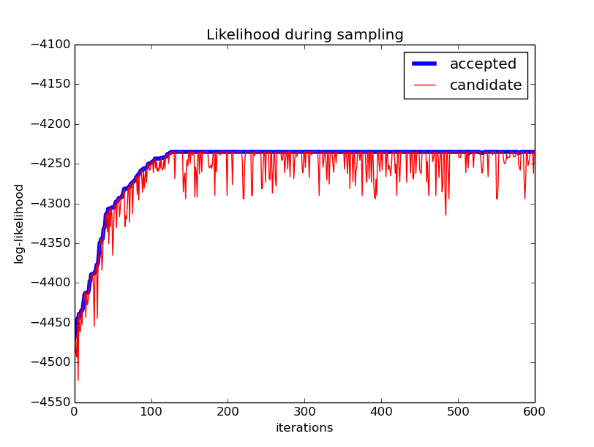
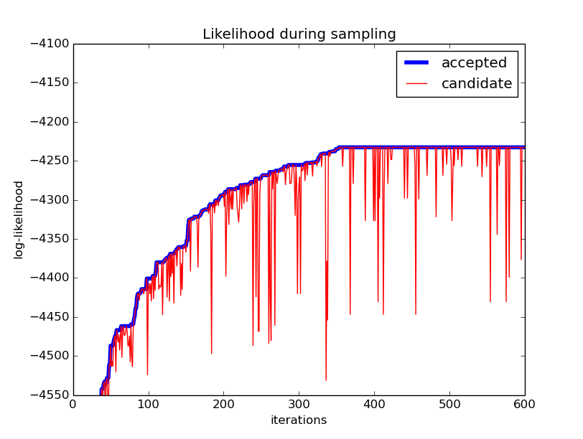
Comparison between grammars
Likelihood
Highly ambiguous
Half ambiguous
Deterministic

Slide 19
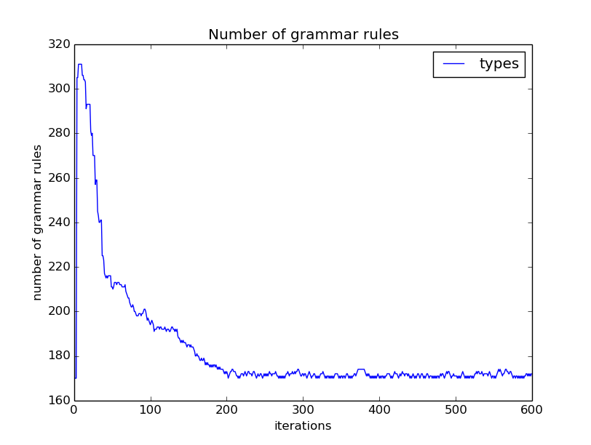
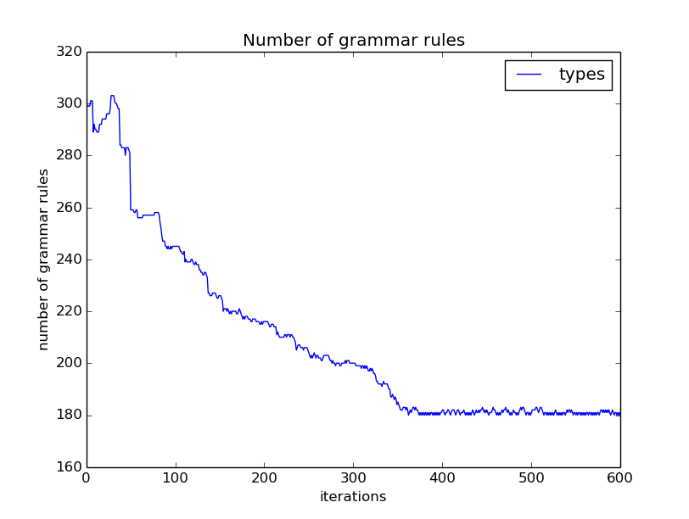
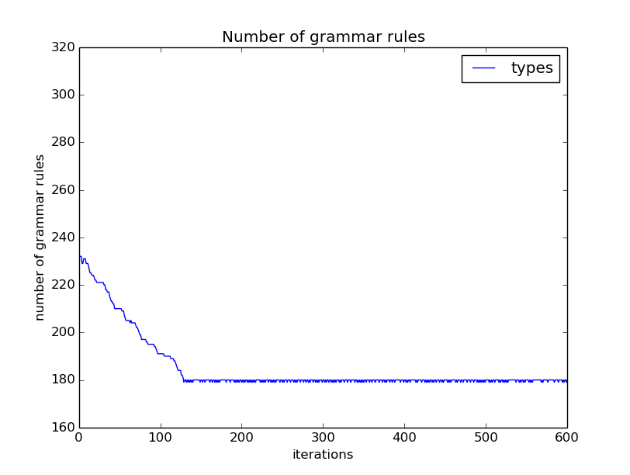
Comparison between grammars
Count of used rules
Highly ambiguous
Half ambiguous
Deterministic

Slide 20
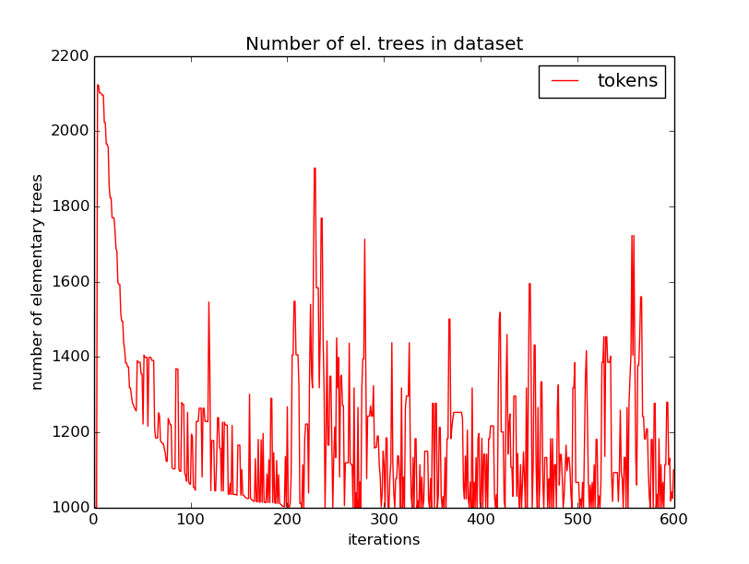
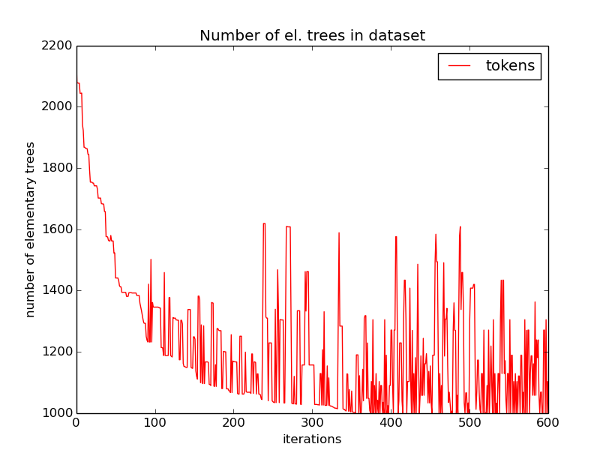
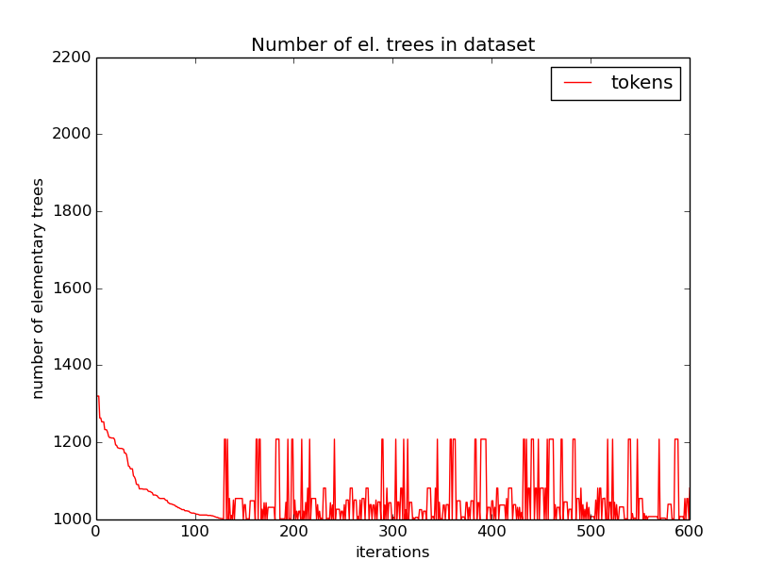
Comparison between grammars
Grammar size
Highly ambiguous
Half ambiguous
Deterministic

Slide 21
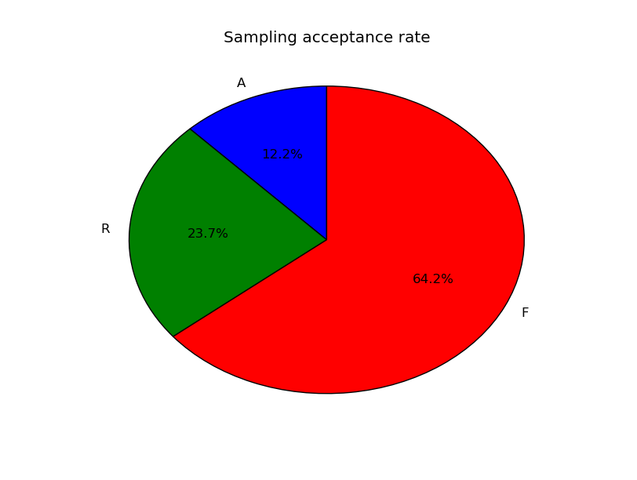
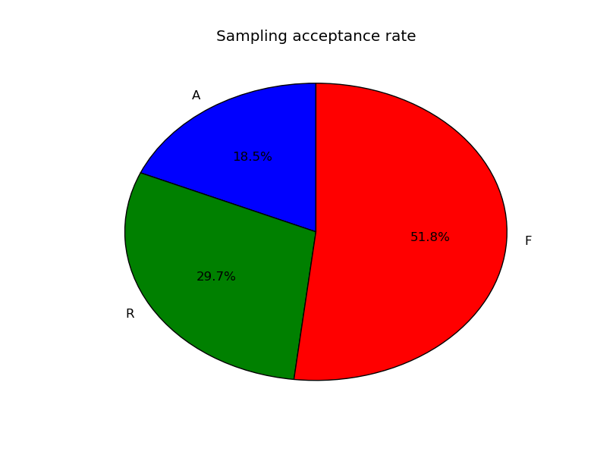
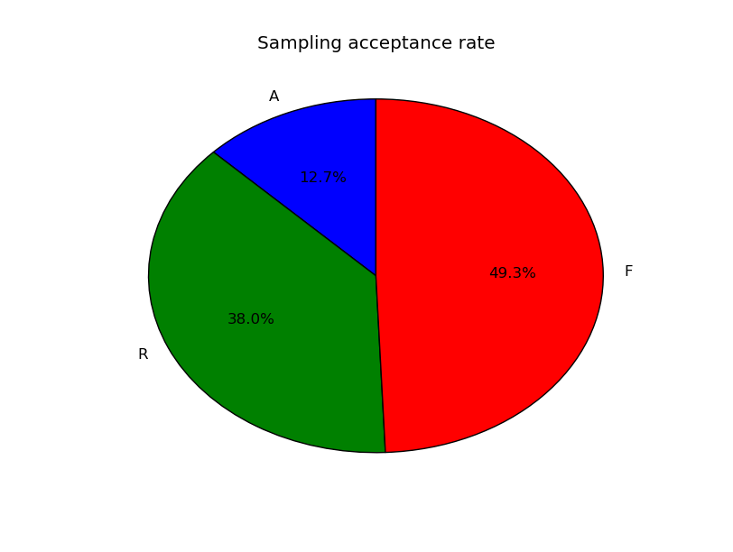
Comparison between grammars
Acceptance rate
Highly ambiguous
Half ambiguous
Deterministic

Slide 22
Comparison: viterbi vs inside
Experiment: use same data set and sample
using inside probability
using viterbi probability
What are the differences?

Slide 23
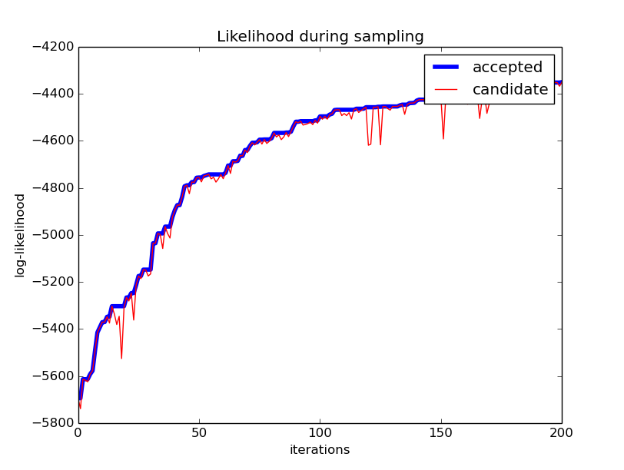
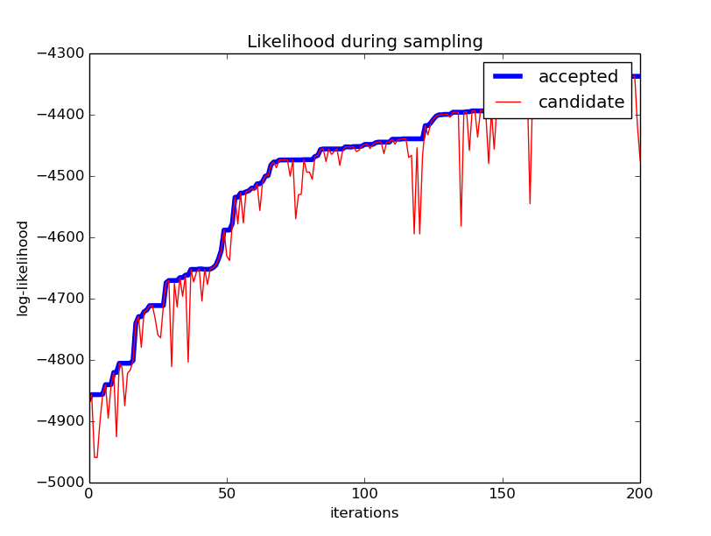
Comparison: viterbi vs inside
viterbi inside

Slide 24

Comparison: Sampled distributions

Slide 25
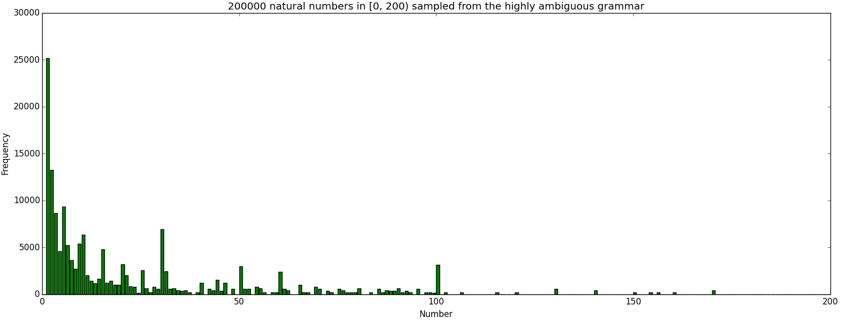
Comparison: Sampled distributions

Slide 26
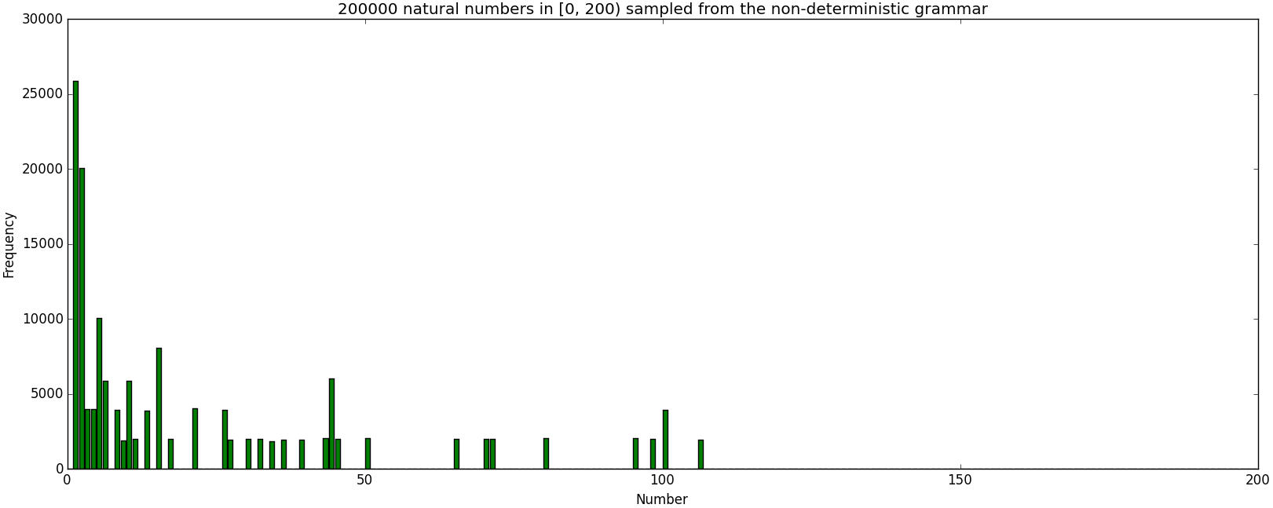
Comparison: Sampled distributions

Slide 27
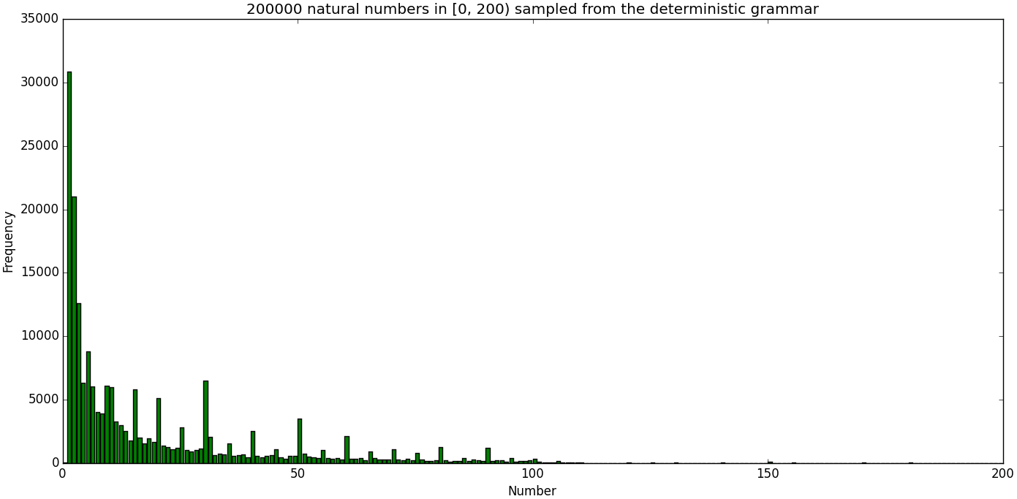
Comparison: Sampled distributions

Slide 28
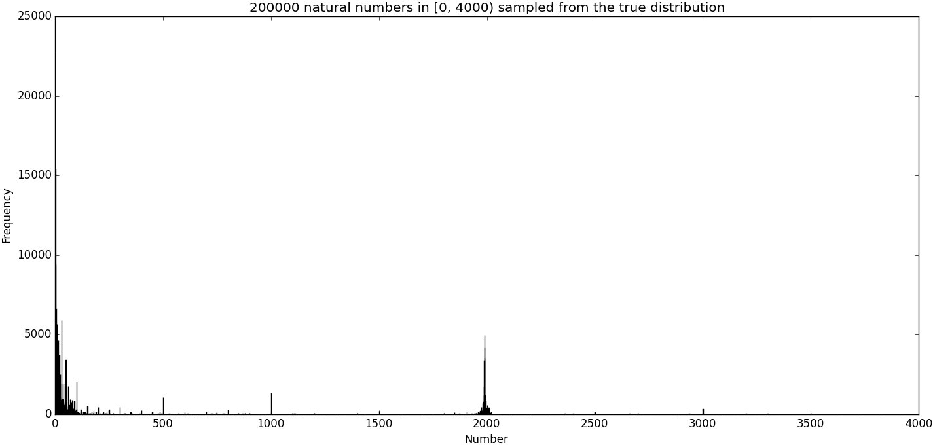
Comparison: Sampled distributions

Slide 29
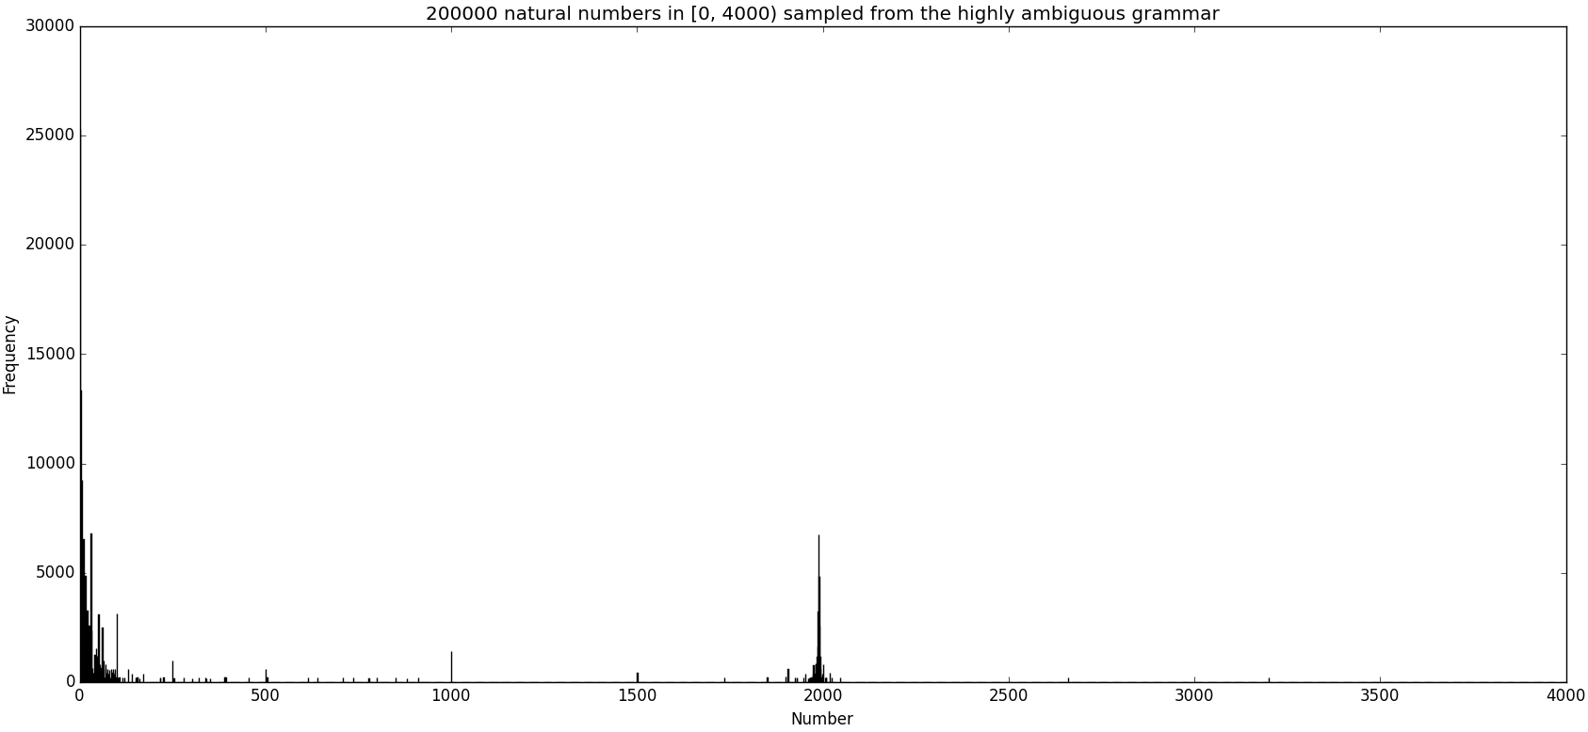
Comparison: Sampled distributions

Slide 30
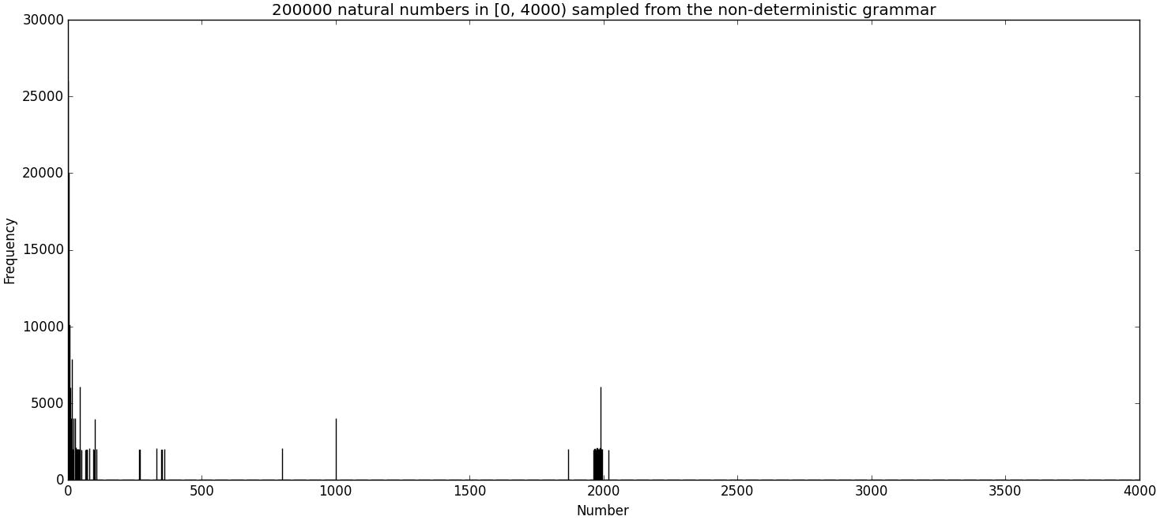
Comparison: Sampled distributions

Slide 31
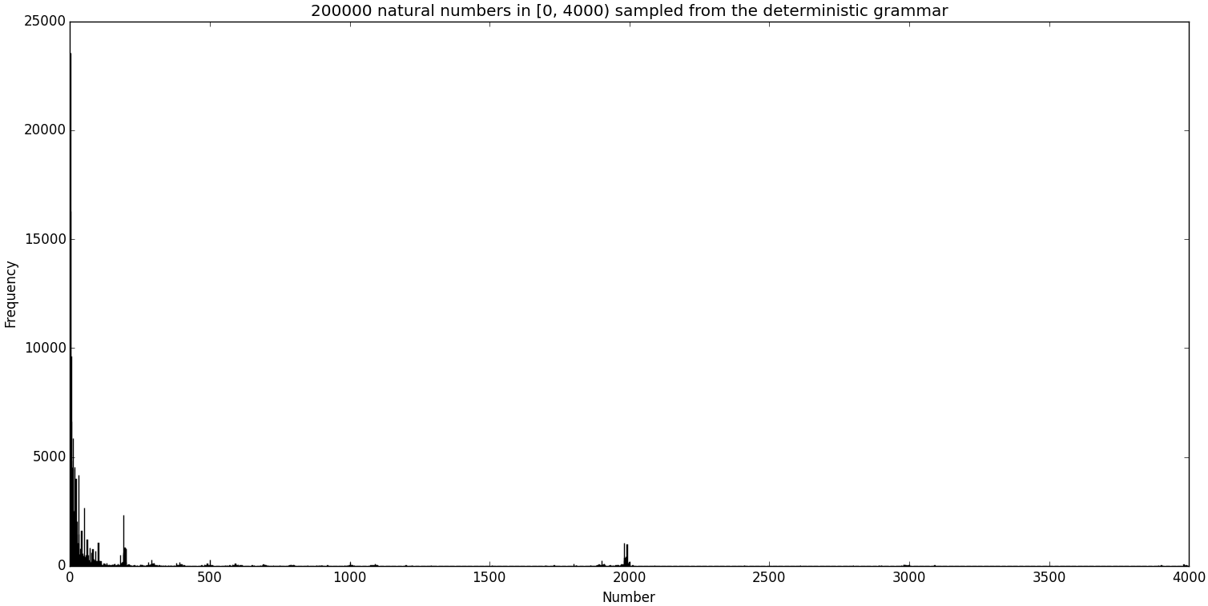
Comparison: Sampled distributions

Slide 32
Questions & Answers

Slide 33
Thank you for your attention

